Slide 1
3D Printer Update and Autolevel
Group 2
Shamini Koravuna
Michael Joy Mathew
Uday Kumar Surepally
Jagadish Subrayan Potty Harikrishnan
Project Lab for Embedded Systems
27/06/2017

Slide 2
Abstract
3D Printing has been around since the early twentieth century and was unfold from automated production.
Applications were made progress to other industries, including medical, aerospace, construction, etc.
Working of 3D printer, its faults and solutions along with further updates are explained.

Slide 3
Agenda
3D Printer
Components
Ramps Board
Alignment of Different Components
Basic Block Diagram
Software and Firmware
Troubleshooting
Advantages and Disadvantages
Applications and Future Scope
Conclusion
References

Slide 4
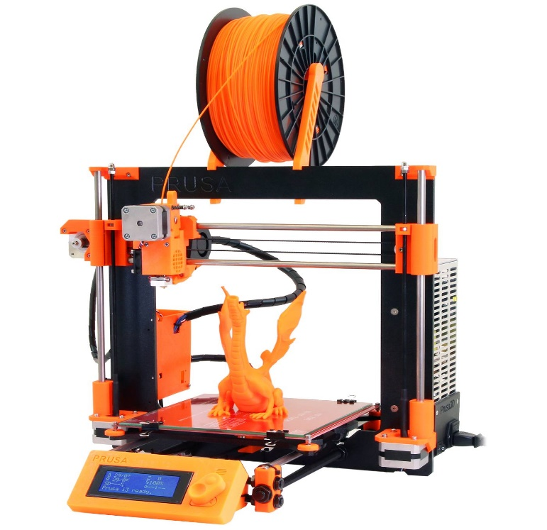
3D Printer
3D printing or additive Manufacturing.
It is a method of converting a virtual 3D model into a physical object.
Where a 3D object is created by laying down successive layers of material.
The first working 3D printer was created in 1984 by Charles Deckard Hull of 3D Systems Corp.
We are using Prusa i3 3d printer developed by Josef Prusa.
Source :Prusa

Slide 5
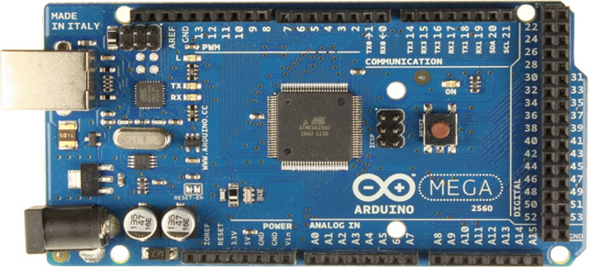
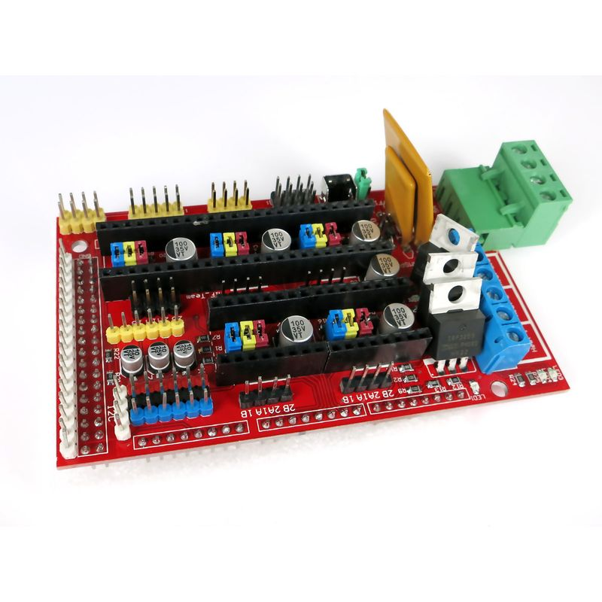
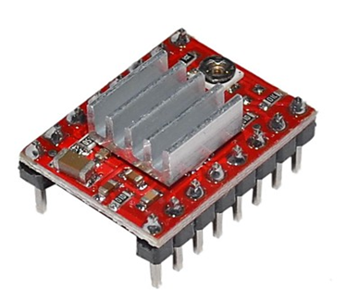
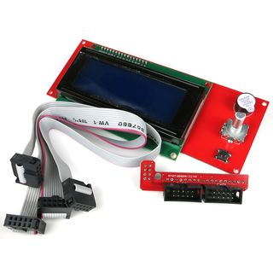
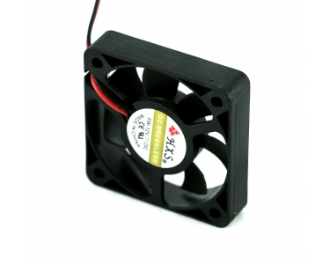
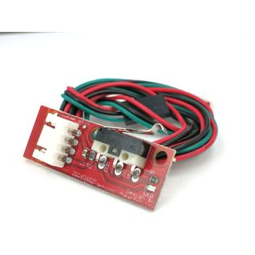
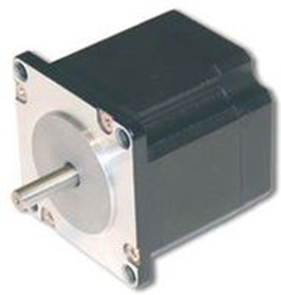
Components
Ardiuno Atmega 2560
Ramps 1.4 controller
A4988 StepStick (5)
LCD display
Fan
End Stop Switch (3)
Motor

Slide 6
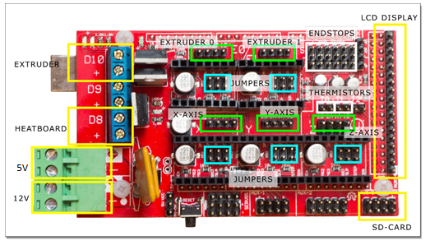
Ramps Board
Developed by Johnnyr
Description:
Arduino MEGA based modular RepRap electronics
It shares circuitry concepts like stepper driver, Thermistor, LCD, heater MOSFET’s etc., with many other electronics.
Features:
License: GPL
Easier to troubleshoot
Up to 1/16 microstepping
Compatible Firmware:
Marlin
Sprinter
Teacup
Source: reprap.org/wiki/RAMPS_1.4

Slide 7
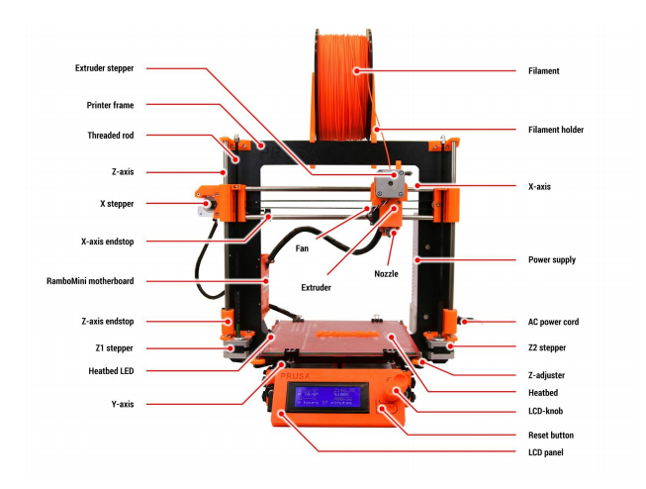
Alignment of different Components
Source:3d Printing Hand Book

Slide 8
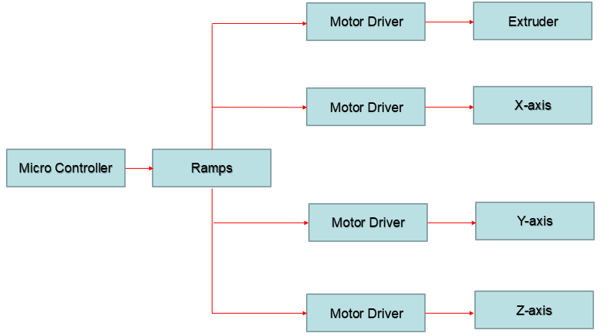
Basic Block Diagram

Slide 9
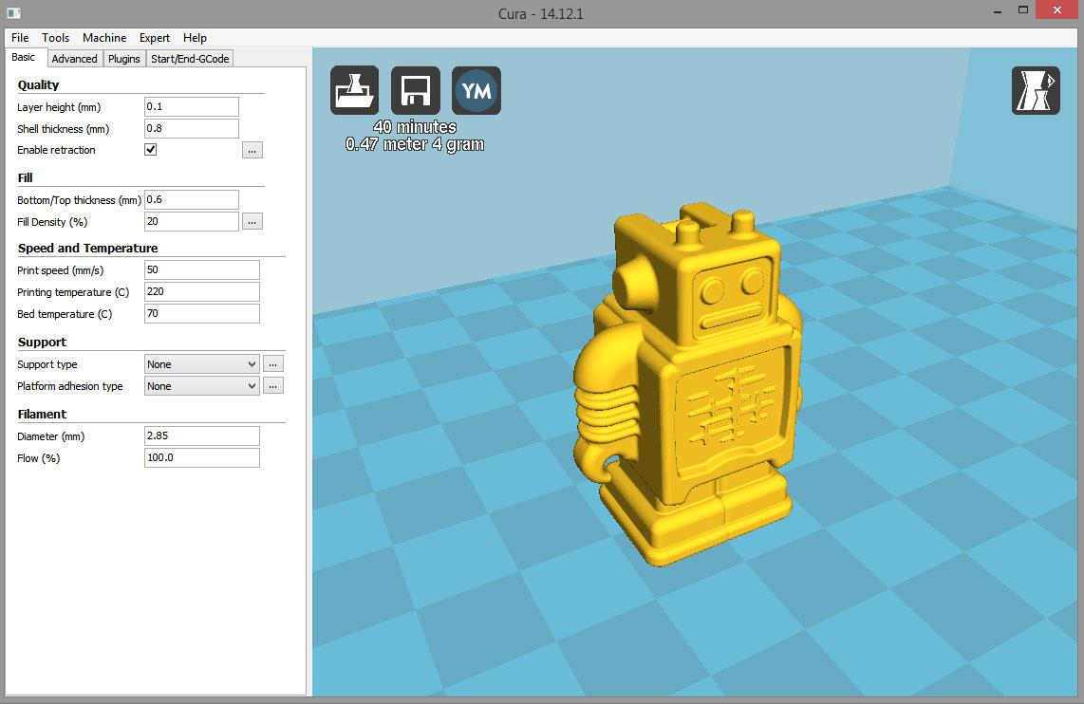
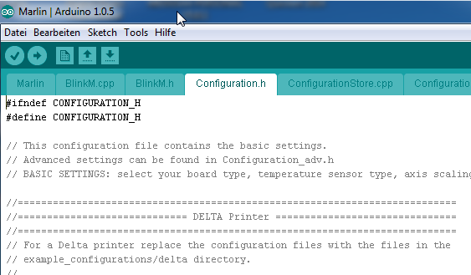
Software and Firmware
Software-Cura:
Using a software called Slicer, the file uploaded is sectioned to different layers.
This layered file is converted to G code for controlling the motion of automated parts of the printer.
File used can be any of STL, OBJ or 3MF format.
Firmware-Marlin:
A 3D printer firmware used for the processing of Arduino.
Composed of files required for all the components used.
Most of the parameters for safe operation of the printer is in “Configuration.h” file.
Settings can be changed according to the requirements.
Source: Cura
Source: Marlin

Slide 10
Troubleshooting(1)
Drivers:
Cause : Motor is not working
Solution: Check the motor driver using Multimeter.
Cause : Jittering
Solution: Calibrate the motors by adjusting the Potentiometer in the driver circuit
(there will be a small knob to adjust) and axes parameters in the display.
Steps:
Main Menu Motion Axes Distance to Calibrate Select the motor to calibrate.
Do this Step until Motor works smoothly in all directions.

Slide 11
Troubleshooting(2)
Cause : Printing in lopsided manner.
Solution: One of the Z-axis motors not moving due to loose contact/communication loss.
Cause : X-axis at an inclined position.
Solution: X-ender bolt had loosened (wear and tear) ,fixed it again.
Cause : While auto-levelling Y-axis ,jittering of motor.
Solution: Check the motor connections.
Cause : One side of print getting smudged.
Solution: The bed height and inclination was adjusted.
Cause : The filament is not sticking to the bed.
Solution: The bed temperature was increased.

Slide 12
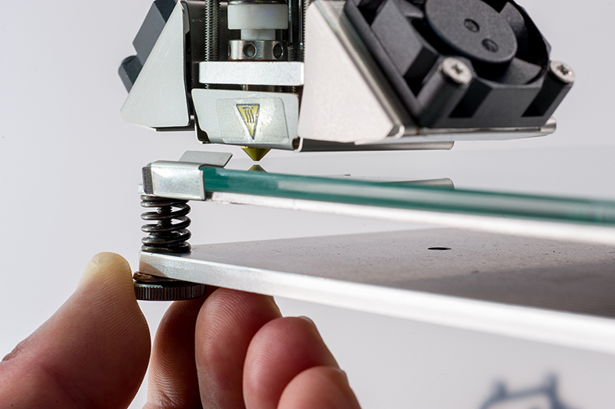
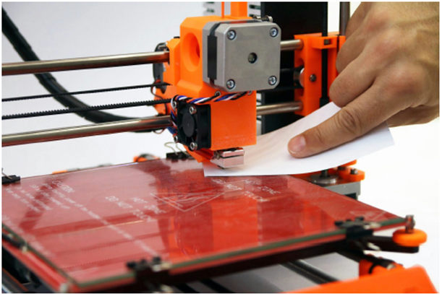
Troubleshooting(3)
Extruder and Bed:
Cause : Printing is not proper
Solution(1) : Adjust the Bed Level
Solution(2) : Distance between Hotend and Bed level should be a paper size and
this should be summarize in all four corners of the heat bed.

Slide 13
Troubleshooting(4)
Firmware:
Updated to the newest version Marlin 1.1.3.
Bugs were happened to be observed which changed the device behavior.
Solution was able to be found in configuration.h file.
Baud rate is set to 250000 as
#define BAUDRATE 250000
Disabled Thermal protection by commenting it as
//#define THERMAL_PROTECTION_HOTENDS
//#define THERMAL_PROTECTION_BED
Disabled PID value which controls the speed of Bed heating as
//#define PIDTEMPBED

Slide 14
Troubleshooting(5)
Changed the value of mechanical endstop in relation with the axis as
X_MIN_ENDSTOP_INVERTING = true
Y_MIN_ENDSTOP_INVERTING = true
Z_MIN_ENDSTOP_INVERTING = true
X_MAX_ENDSTOP_INVERTING =true
Y_MAX_ENDSTOP_INVERTING = false
Z_MAX_ENDSTOP_INVERTING = false
Z_MIN_PROBE_ENDSTOP_INVERTING = false
Stepper direction is inverted to
#define INVERT_X_DIR true
#define INVERT_Y_DIR false
#define INVERT_Z_DIR true
Direction of the Extruder motor changed to
INVERT_E0_DIR false

Slide 15
Troubleshooting(6)
Changed the values of travel limits after homing as:
#define X_MIN_POS 120
#define Y_MIN_POS 120
#define Z_MIN_POS 150
#define X_MAX_POS 200
#define Y_MAX_POS 200
#define Z_MAX_POS 200
After modifying the values, irregularities in the home position of all 3 axes were discovered. Therefore, the values were re-modified to
#define X_MIN_POS 0
#define Y_MIN_POS 0
#define Z_MIN_POS 0
#define X_MAX_POS 200
#define Y_MAX_POS 200
#define Z_MAX_POS 200

Slide 16
Advantages and Disadvantages
Advantages:
Produces complex products
Spare parts can be printed on site which will eliminate shipping cost.
Re-invent already invented products
Printing 3D organs can revolutionarize the medical industry.
Less Cost compared to all other 3D printer.
Disadvantage:
Consumes more time for less complicated parts.
Size of printable object is limited by the movement of extruder.
In Additive Manufacturing previous layer has to harden before creating next year.
Curved geometry will not be much accurate while printing.

Slide 17
Further updates
Inclusion of Auto level sensor
Automatic levelling of Z axis with respect to the Heat bed.
Z axis is tuned such that there exists a constant distance between the nozzle and the bed.
Made possible by using Proximity sensor connected besides the Extruder.
Sensor calculates the distance by moving over the bed.
Uneven surfaces on the print bed will be noticed by the firmware and will instruct the nozzle to move accordingly.
No need of End stop for the Z axis.
Can be used for inclined Heat bed.

Slide 18
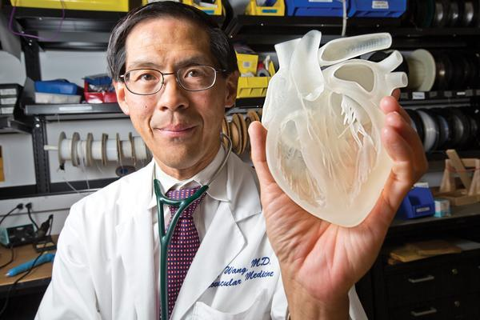
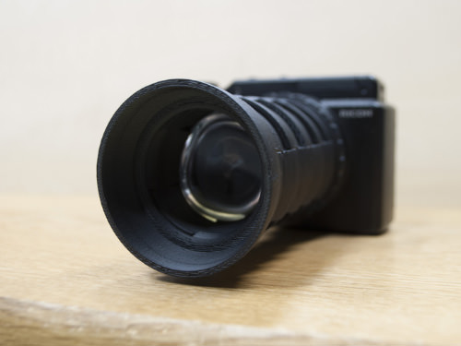
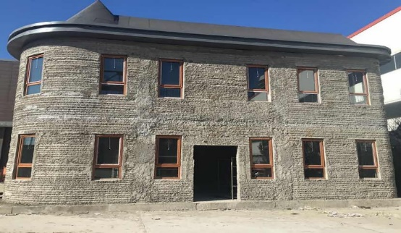
Applications and Future Scope
Applications:
Medical
Technology
Rapid Prototyping
Automobiles
Mass Customization
Mostly Everything…!
Future Scope:
Rocket Engine
3D Printing in Space
3D Bio -Printing
Source:https://3dprint.com/124954/3d-printed-heart-saves-baby/
https://www.thingiverse.com/thing:37147
http://inhabitat.com/3d-printed-house-in-china-can-withstand-an-8-0-earthquake/

Slide 19
Conclusion
Many challenges were faced for Prusa i3.
Mandatory to analyze the calibration of Z axis with the heat bed.
Safety features like Thermistor and Heat bed temperature protection and PID (Proportional Integral and Derivative) setting of Heat bed is must.
Besides the minor faults, it is a good version of 3D printer.

Slide 20
References
http://www.prusaprinters.org
http://reprap.org/wiki/Marlin
http://reprap.org/wiki/RAMPS_1.4
http://reprap.org/wiki/StepStick
https://www.arduino.cc/en/Main/ArduinoBoardMega2560
https://github.com/MarlinFirmware/Marlin
http://www.prusa3d.com/downloads/manual/prusa3d_manual_175_en.pdf
https://www.youtube.com/user/ThomasSanladerer
http://forums.reprap.org/read.php?4,614214
https://www.simplify3d.com/support/print-quality-troubleshooting/#extruding-too-much-plastic
https://3dprintingforbeginners.com/troubleshoot-3d-printing-problems/
https://all3dp.com/1/common-3d-printing-problems-troubleshooting-3d-printer-issues/
Maintaining and Troubleshooting Your 3D Printer by Charles Bell
“3D Printing For Dummies” by Kalani Kirk Hausman
“3D Printing with SketchUp” by Marcus Ritland

